Slide 1
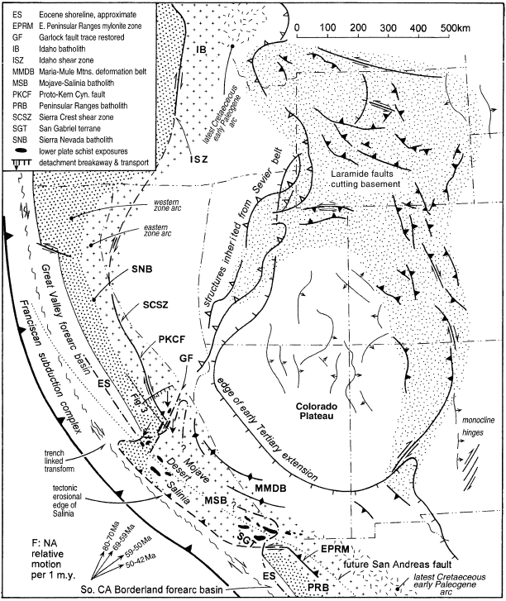
Segmentation of the Laramide Slab – evidence from the southern Sierra Nevada region
Jason Saleeby, 2003
Laramide Orogeny: Late Cretaceous – early Paleogene
Related to flattening of subducting slab
Associated with end of Cretaceous Sierran magmatism
Saleeby suggests Laramide slab segmented, causing different structural changes in north vs. south during subduction
Shallow southern segment experienced deformation, denudation and westward breaching of ~500 km wide section of cordilleran batholith
segment correlated with plate margin and intracontinental deformation
Methods:
Petrologic analysis of xenoliths from Sierra Nevada Batholith (SNB)
Cross-section of oblique crustal section in central-southern SNB & MSB
Presence of exposed lower plate schists
Deformation along N-NE corridor from Wyoming to SW Arizona, inboard of Sevier fold & thrust belt
Deformation associated with flat-slab subduction of southern segment
Reconstruction of Laramide-age tectonic elements (~ 60 Ma) in southwest and Basin & Range province, on pre-Neogene base.
Notes:
Pre-Neogene palinspastic base = inferred pre-Neogene positions of southwest Cordillera region

Slide 2
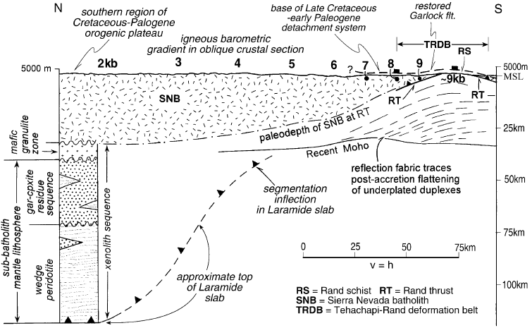
Two different sub-batholithic sections with contrasting deep crust-upper mantle structures → suggest a structural change must have occurred during Laramide
Inflection forms “ramp” in subducting slab
“Inflection” of the Laramide slab
Northern domain: deep slab segment
mantle lithosphere remained intact throughout Laramide
Southern domain: shallow slab segment
Rand thrust removed batholithic crustal base and upper mantle
Notes:
Note: X-section restored to pre-Neogene position to realign high-angle normal faults in TRDB

Slide 3
Southward deepening oblique crustal section
Miocene age xenoliths reveal lithospheric composition of SNB:
Granitic batholith (30-35 km thick)
10 km granulite-batholith transition zone
35 km mafic-ultramafic cumulates and residues; garnet-clinopyroxenite
Underlain by garnet-peridotite mantle to ~125 km
Remained intact at least until mid-Miocene
Tehachapi-Rand belt to south much deeper
Cooling ages of schists indicate late Cretaceous emplacement
Base of batholithic crust and underlying mantle lithosphere were tectonically removed
Replaced by Rand schist (“schist underplating”)
(7 km)
(35 km)
End of batholithic magmatism in SNB caused by disruption of asthenosphere flow pattern
Notes:
Eclogite xenoliths in Miocene volcanic deposits provide composition constraints of lithosphere
Schists exposed along Garlock Fault
Rand schist = greenschist-amphibolite facies, from protoliths encompassing Franciscan trench and Great Valley forearc basin
This schist family tectonically underlies batholitith rocks at comparable structural levels throughout SoCal

Slide 4
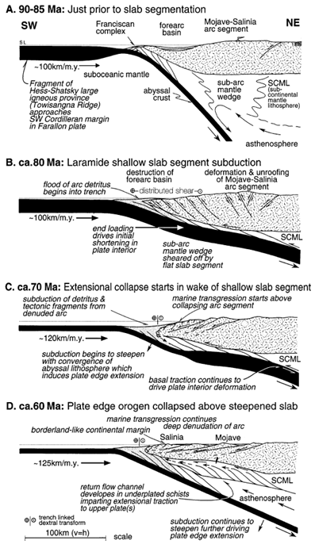
Time slice models of SW Cordilleran plate edge in MSB region
Show sequence leading to uplift and collapse of Mojave-Salinia batholithic belt region.
Notes:
Laramide shallow slab segment deformed forearc-arc region as subduction flattened
Then as subduction steepened, regional extension promoted orogenic collapse and forearc breachment of the disrupted arc segment

Slide 5
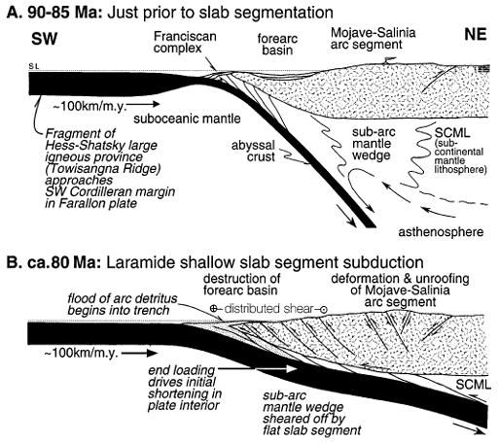
A: MSB prior to arrival of Towisangna Ridge at plate margin
B: Ridge-hosting lithosphere more buoyant than abyssal lithosphere, causing subduction angle to decrease
Subarc mantle wedge sheared off, displaced downdip into mantle
Subsequent end loading caused early craton deformation (shortening)
Basement-involved thrusts activated
mantle wedge-driven arc magmatism ends
Imbrication of forearc basin
Subduction is oblique – dextral & sinistral components
Uplift & denudation of MSB arc – detritus flood the trench
Schist underplating begins – contributing to crustal thickening, isostatic uplift (more susceptible to gravitational collapse)
Notes:
MSB = Mojave-Salinia Batholith!
Contrast of deformation expressions between dextral SNB-MSB and sinistral MSB-PRB reflect obliquity of slab subduction
End loading – slab pulling itself deeper?

Slide 6
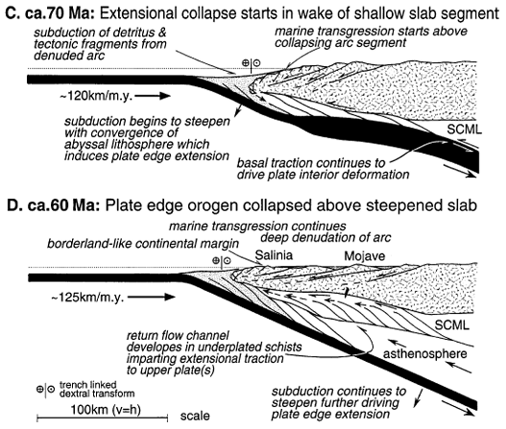
C: Subducting slab begins steepening again as dense abyssal lithosphere reaches trench
Towisangna Ridge trailing flank now beyond plate edge
suction at slab-plate interface Induces extension
Collapse of arc segment/subsidence at plate edge
Marine transgression above collapsing batholithic arc
Slab causing basal traction along lithosphere beneath craton
D: trailing flank of ridge beneath Colorado Plateau
Schist underplating accelerates with steepening
Return flow in accretionary wedge caused extensional traction
Inflow of asthenosphere beneath eastern Mojave
Extension and collapse of orogen
Notes:
Suction along slab upper plate induced by steepening subduction angle – then in turn induced regional extension/subsidence

Slide 7
Takeaways
Tectonic boundary cuts southern Sierra Nevada batholith region into two distinct regions of Mesozoic subduction:
North: deep, higher-angle subduction
South: shallow, low-angle subduction
mantle lithosphere sheared off and transported deeper by shallow Farallon slab segment at ~85 Ma
Late to post-Laramide tectonic collapse of orogenically thickened crust ca. 60-70 Ma
slab steepening beginning ~70 Ma
dextral oblique shear at wedge
weakened mantle lithosphere due to increased hydration of schist underplate
Subduction erosion at continental margin
Extension along plate edge accompanied onset of slab steepening ca. 70 Ma
Evidence of Laramide thrust deformation follows trajectory of flat slab segment – direct link between plate edge and plate interior Laramide deformation
Notes:
Shallow slab carrying aseismic ridge fragment of mafic crustal composition – resulted in it having greater buoyuancy than abyssal lithosphere
End loading during initial shearing + basal traction along base of mantle lithosphere below craton caused pattern of basement deformation

Slide 8
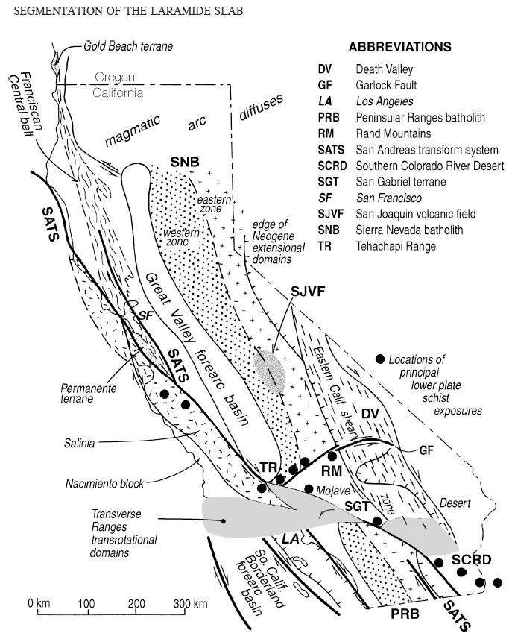
Retrograde metamorphism in upper plate rocks
Schist exposures = underplated beneath MSB
Replacement of sub-batholith mantle lithosphere
From dry, high grade metamorphic rheology to wet, low grade rheology
Significant reduction in material strength
High-water flux migrating from lower to upper plate caused weakening along plate edge
Contributed to orogenic collapse
Note: Neogene Garlock fault surface trace used as “tracer” for inflection point of Laramide slab
relative plate motion in early Laramide parallels trend of GFZ
Modern-day tectonism and restored Neogene systems (Salinia and San Gabriel terrane, Transverse Ranges, Garlock fault displacement, and transtensional strain in DV)
Notes:
distribution of lower plate schists indicate shallow slab segment was ~500 km wide

Slide 9
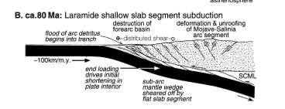
At it’s simplest…. In Saleeby’s words…
1. The Laramide slab possessed a shallow flat segment along an ~500- km-long stretch of the plate edge in the southern California region.
2. Classic Laramide structures of the deformed craton lie in a corridor that corresponds to the shallow flat slab segment with respect to the trajectory of Farallon–North American relative plate motions.
3. A direct causative link between plate edge (California) and plate interior Laramide deformation is implied.
4. It is suggested that end loading during the initial shearing off of the subbatholith mantle lithosphere, joined by basal traction along the base of the subcratonic mantle lithosphere (as the shallow slab segment was subducted), led to the pattern of basement deformation observed in the craton

Slide 10
Resulting from a reconstruction of various terranes (fault-bounded geologic entity of regional extent with specific stratigraphy andhistory)
Salinia terrane = consists of high-grade metamorphic and deep-seated granitic rocks overlain by Upper Cretaceous and Tertiary sedimentary rocks.
San Gabriel Terrane – Precambrian metamorphic rocks along south edge of San Gabriel Mtns (SGT)
Rotation and translation of Transverse Ranges (TR)
Extensional strain in Death Valley

